Slide 1
4.1 Leave A message
As a/an Users, Government Agencies, User Support, Administrator I would like to Leave the helpdesk a message.
Donation Solution
Class Diagram
Home Page
Message: String DonationInstruction: String Activities board: List OrganizationDescription: String
construct() LoadInformationFromDB() ShowOrganizationDescription() sendMessage() showActivity()
IT Help Desk
Message: String Email: object
construct() readMessage() sendResponse()
Send Message

Slide 2
4.2 Contact Information
As a/an Users, Government Agencies, Non Profit Organizations, Delivery Systems, Financial Manager, Distribution Manager I want to View Contact Information of the Help Desk so that I can View Contact Information of the Help Desk
Donation Solution
Class Diagram
Home Page
Contact Information: String Message: String DonationInstruction: String Activities board: List OrganizationDescription: String
construct() LoadInformationFromDB() ShowOrganizationDescription() showActivity()

Slide 3
5.1 Administrator Account Sign In
As a/n Administrator I would like to Have an option for an Administrator login. so that I can Perform duties on application with elevated privileges.
Donation Solution
Class Diagram
Administrator Account
Id : Integer First_name : varchar Last_name : varchar Email : varchar Phone : varchar Street1 : varchar Street2 : varchar City : varchar State: varchar Zip_Code : varchar
construct() RequestLogin() requestLogOut() showFailMessage() requestAuthentication() Authenticate()
Home Page
Donation Instruction: String Activities board: List OrganizationDescription: String
construct() LoadInformationFromDB() ShowOrganizationDescription() showActivity()
Log in
Authenticate

Slide 4
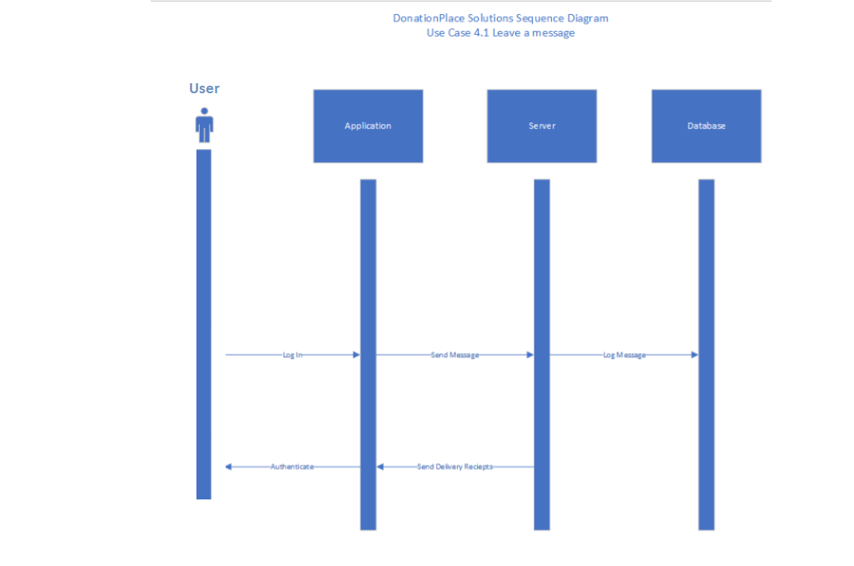
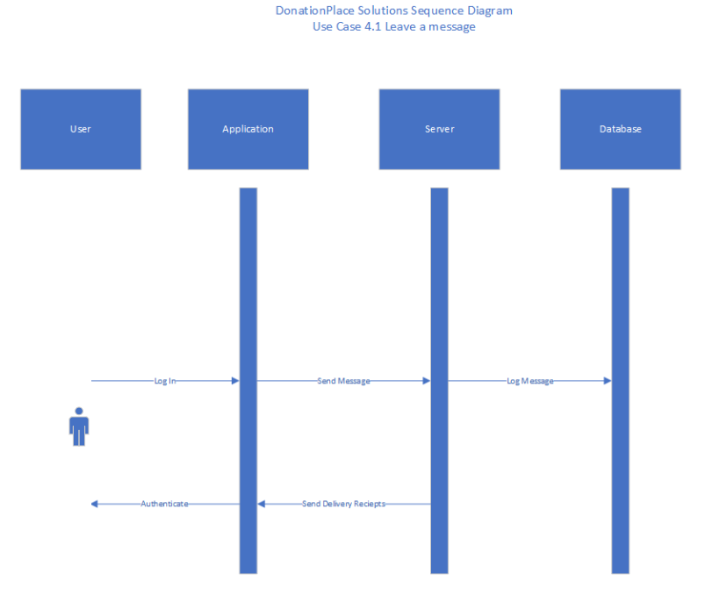

Slide 5
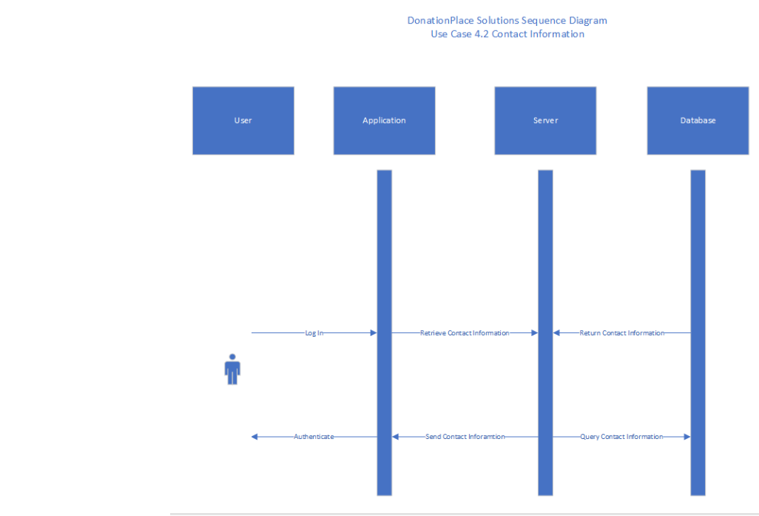
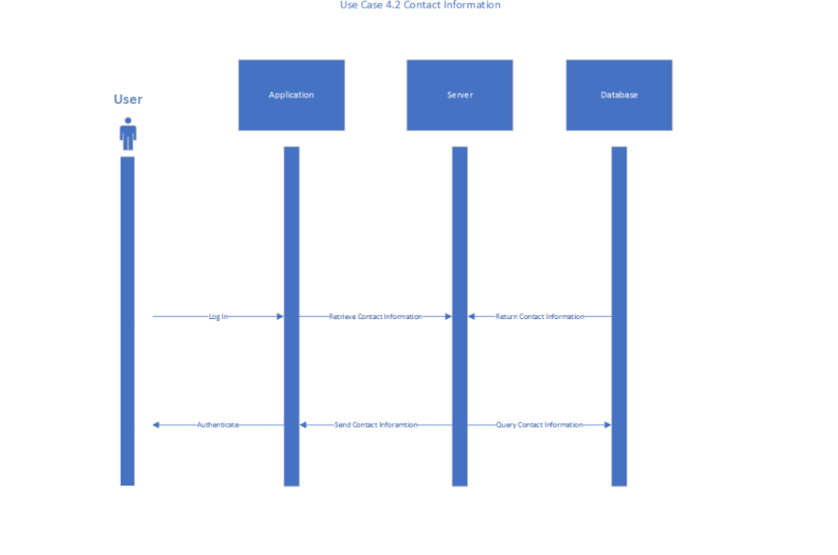

Slide 6
